Slide 1
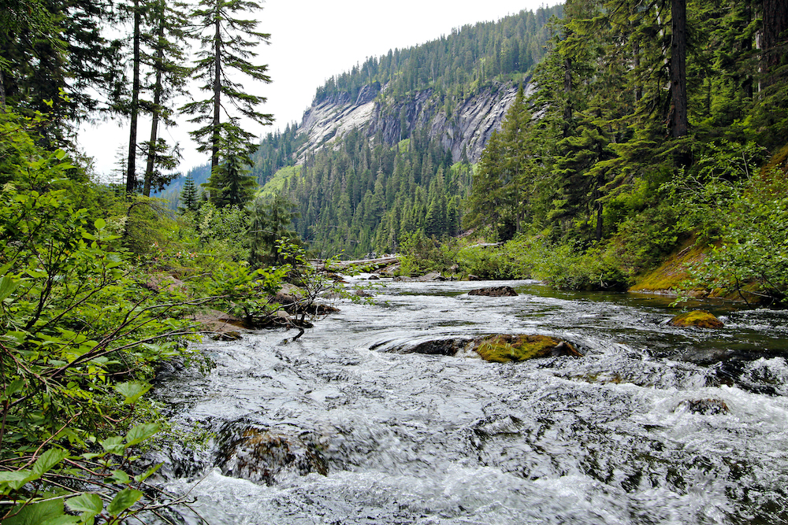
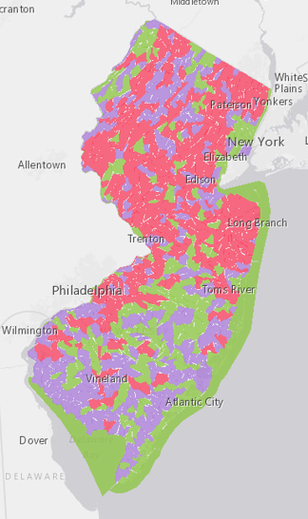
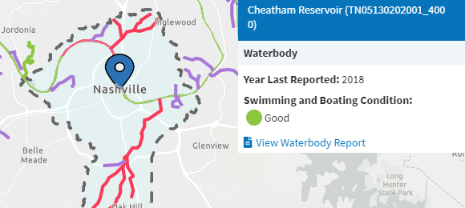
How’s My Waterway : Telling the Water Story
Dwane Young, US EPA Office of Water

Slide 2
Pulling the Pieces Together: Telling the Water Story
Provide the public with usable, meaningful information
Communicate progress states, tribes, and EPA are making towards restoring or protecting water quality
Engage the public in understanding impacts on water and issues related to water

Slide 3
How’s My Waterway
Geospatial Integration and Open Data
Shared Components (Glossary, SRS, CDX, Tribal Lands)
Open APIs (WQP, ATTAINS, ECHO, SDWIS, etc.)
Common Cataloging Approaches / Geospatial Referencing
Electronic Reporting (ATTAINS)
Shared Governance and Design
Data Standards (i.e. WQX)

Slide 4
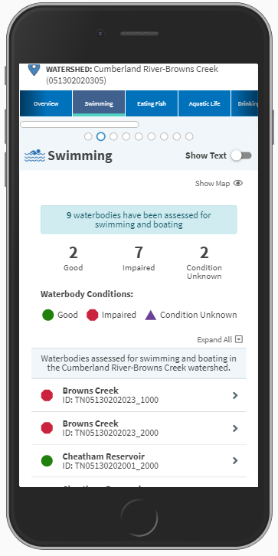
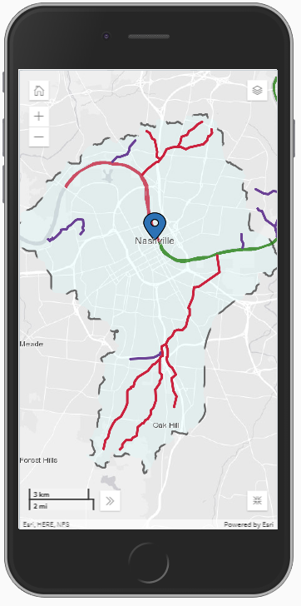
How’s My Waterway: Principles
All information is based on a service (API First Strategy)
Data standards matter
Mobile first design
Integrate data across systems
Shared ownership between states/tribes/EPA
User centered design
Strategy for navigating ‘Change’

Slide 5
How’s My Waterway
https://mywaterway.epa.gov

