Slide 1
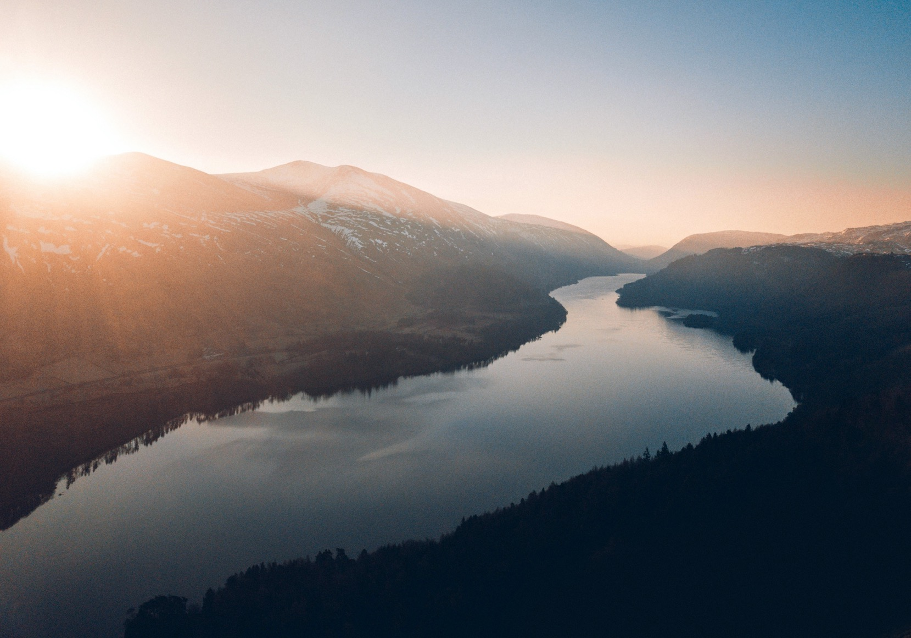
Partnerships for progress

Slide 2
VISION
The Internet of Water envisions a world engaged in sustainable water resources management and stewardship enabled by
open, shared, and integrated water data.
Notes:
PETER

Slide 3
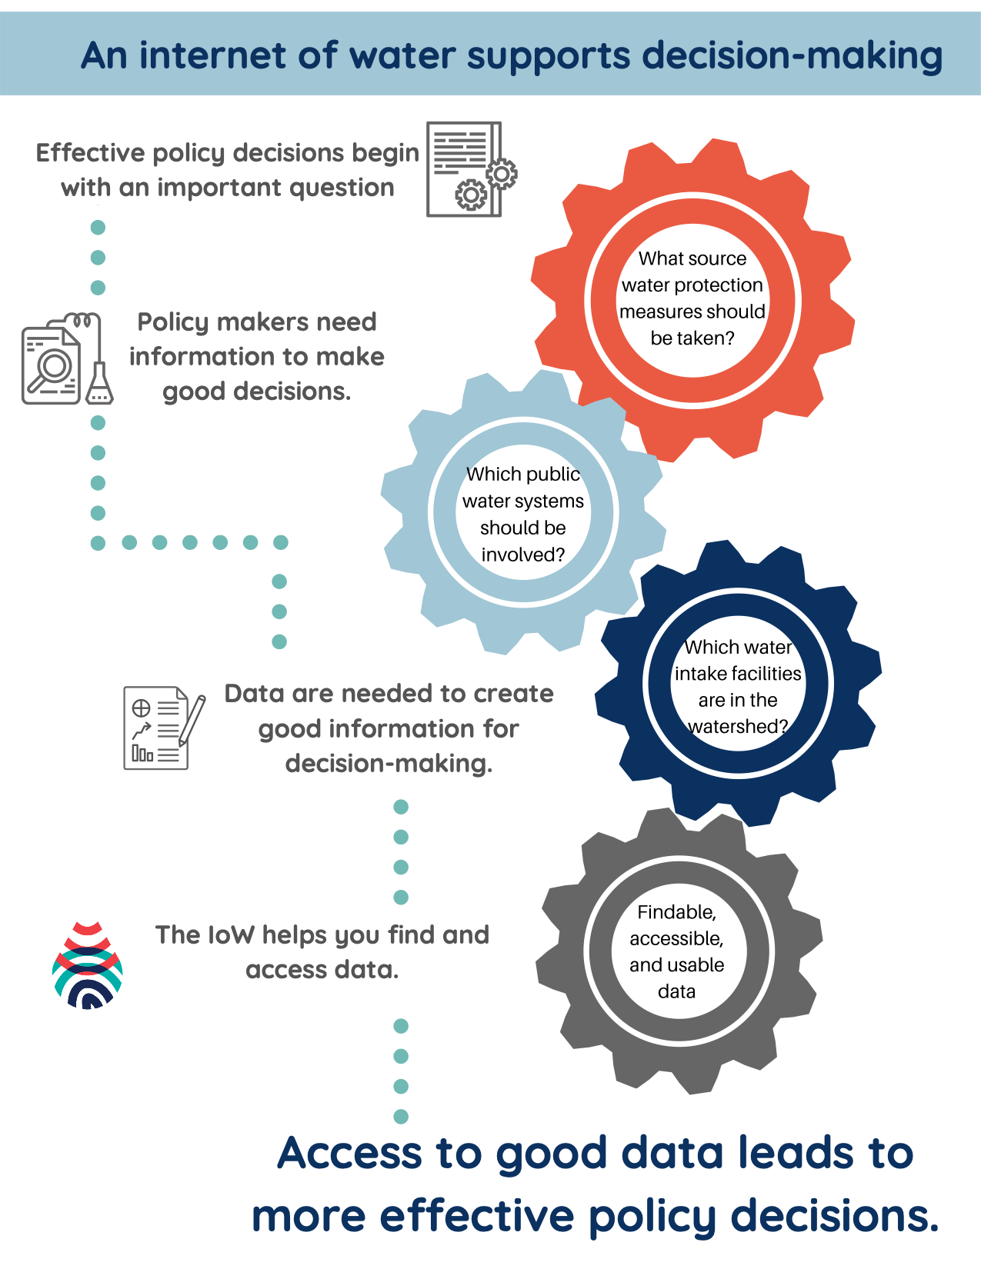
Notes:
KYLE
Policy: What source water protection measures should be taken?
Information: Which public water systems should be involved?
Data need: Which water intake facilities are in the watershed?
Findable, accessible, useable data.

Slide 4
Integrated management requires
integrated data
Notes:
And that’s the bottom line, to manage water resources sustainably, the management has to be integrated, and integrated management needs integrated data. If you think about data as pieces of a puzzle, and your watershed as the puzzle you are trying to construct. Currently, there are hundreds of different actors holding pieces of the puzzle. You ever do a puzzle with kids who likes to steal pieces so they can put the last one in… and they forget where they hid the pieces… it’s a little like that. It’s really hard to find these different pieces. Even when you do, you might not be able to get the pieces because of technical or social barriers. And once you get the piece you might find it’s a wooden piece, but most of your puzzle pieces are made out of paperboard.

Slide 5
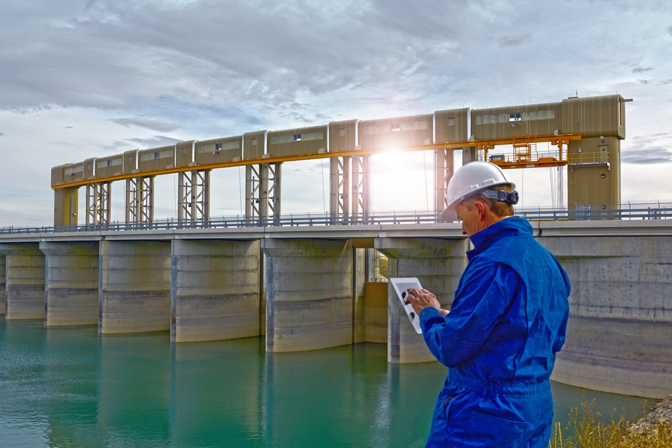
FAIR Data – A Summary
Findable – data have persistent identifiers and are indexed in searchable resource;
Accessible – data are retrievable by their identifier using open protocols;
Interoperable - are machine readable and use shared vocabularies;
Re-usable - data have clear data usage licensing, provenance, and meet community standards

Slide 6
IoW Technical Strategies
Make data accessible and interoperable by making it “API-ready,” and relying on modern APIs following open protocols.
Make granular data discoverable by semantic, hydrologic, and geospatial search using web data best practices
What tools and infrastructure are needed to help data flow?
How do we create community and behavior change around data sharing?
How do we foster willingness to invest resources in water data?
How do we resource those who want to participate?
Notes:
To do that, there are three broad categories of work we are engaging in
First, we are developing technical resources. This includes designing the overall infrastructure for the IoW – how do we create a system that lets data flow seamlessly to address the spatial fragmentation. Once that infrastructure is designed, what open tools and guidance need to help agencies to create the infrastructure needed to participate? How do we help them make their data more findable, accessible, and usable?
Second, there is a big social engagement component. How do we create a unified vision for water data, how do we show the value of water data to answer real-world problems? How do we change behaviors and create a culture that values sharing data for integrated management?
Third, there is a capacity and equity component. But let’s say someone says, yes – we believe in the importance of water data but we don’t have the human or financial capacity to upgrade infrastructure. So we are looking at policy levers to pull – can state revolving funds be used for data infrastructure and not just physical infrastructure, is there a way to match federal grants to data needs, and so on. Water equity is a big conversation that is taking place right now and we are at the forefront of thinking about how to ensure water data equity in the IoW.

Slide 8
Discoverability: project geoconnex.us
https://geoconnex.us
Resources
Linked hydrologic data
Infrastructure
Community-Building
Discovery Tools
Notes:
KYLE

Slide 9
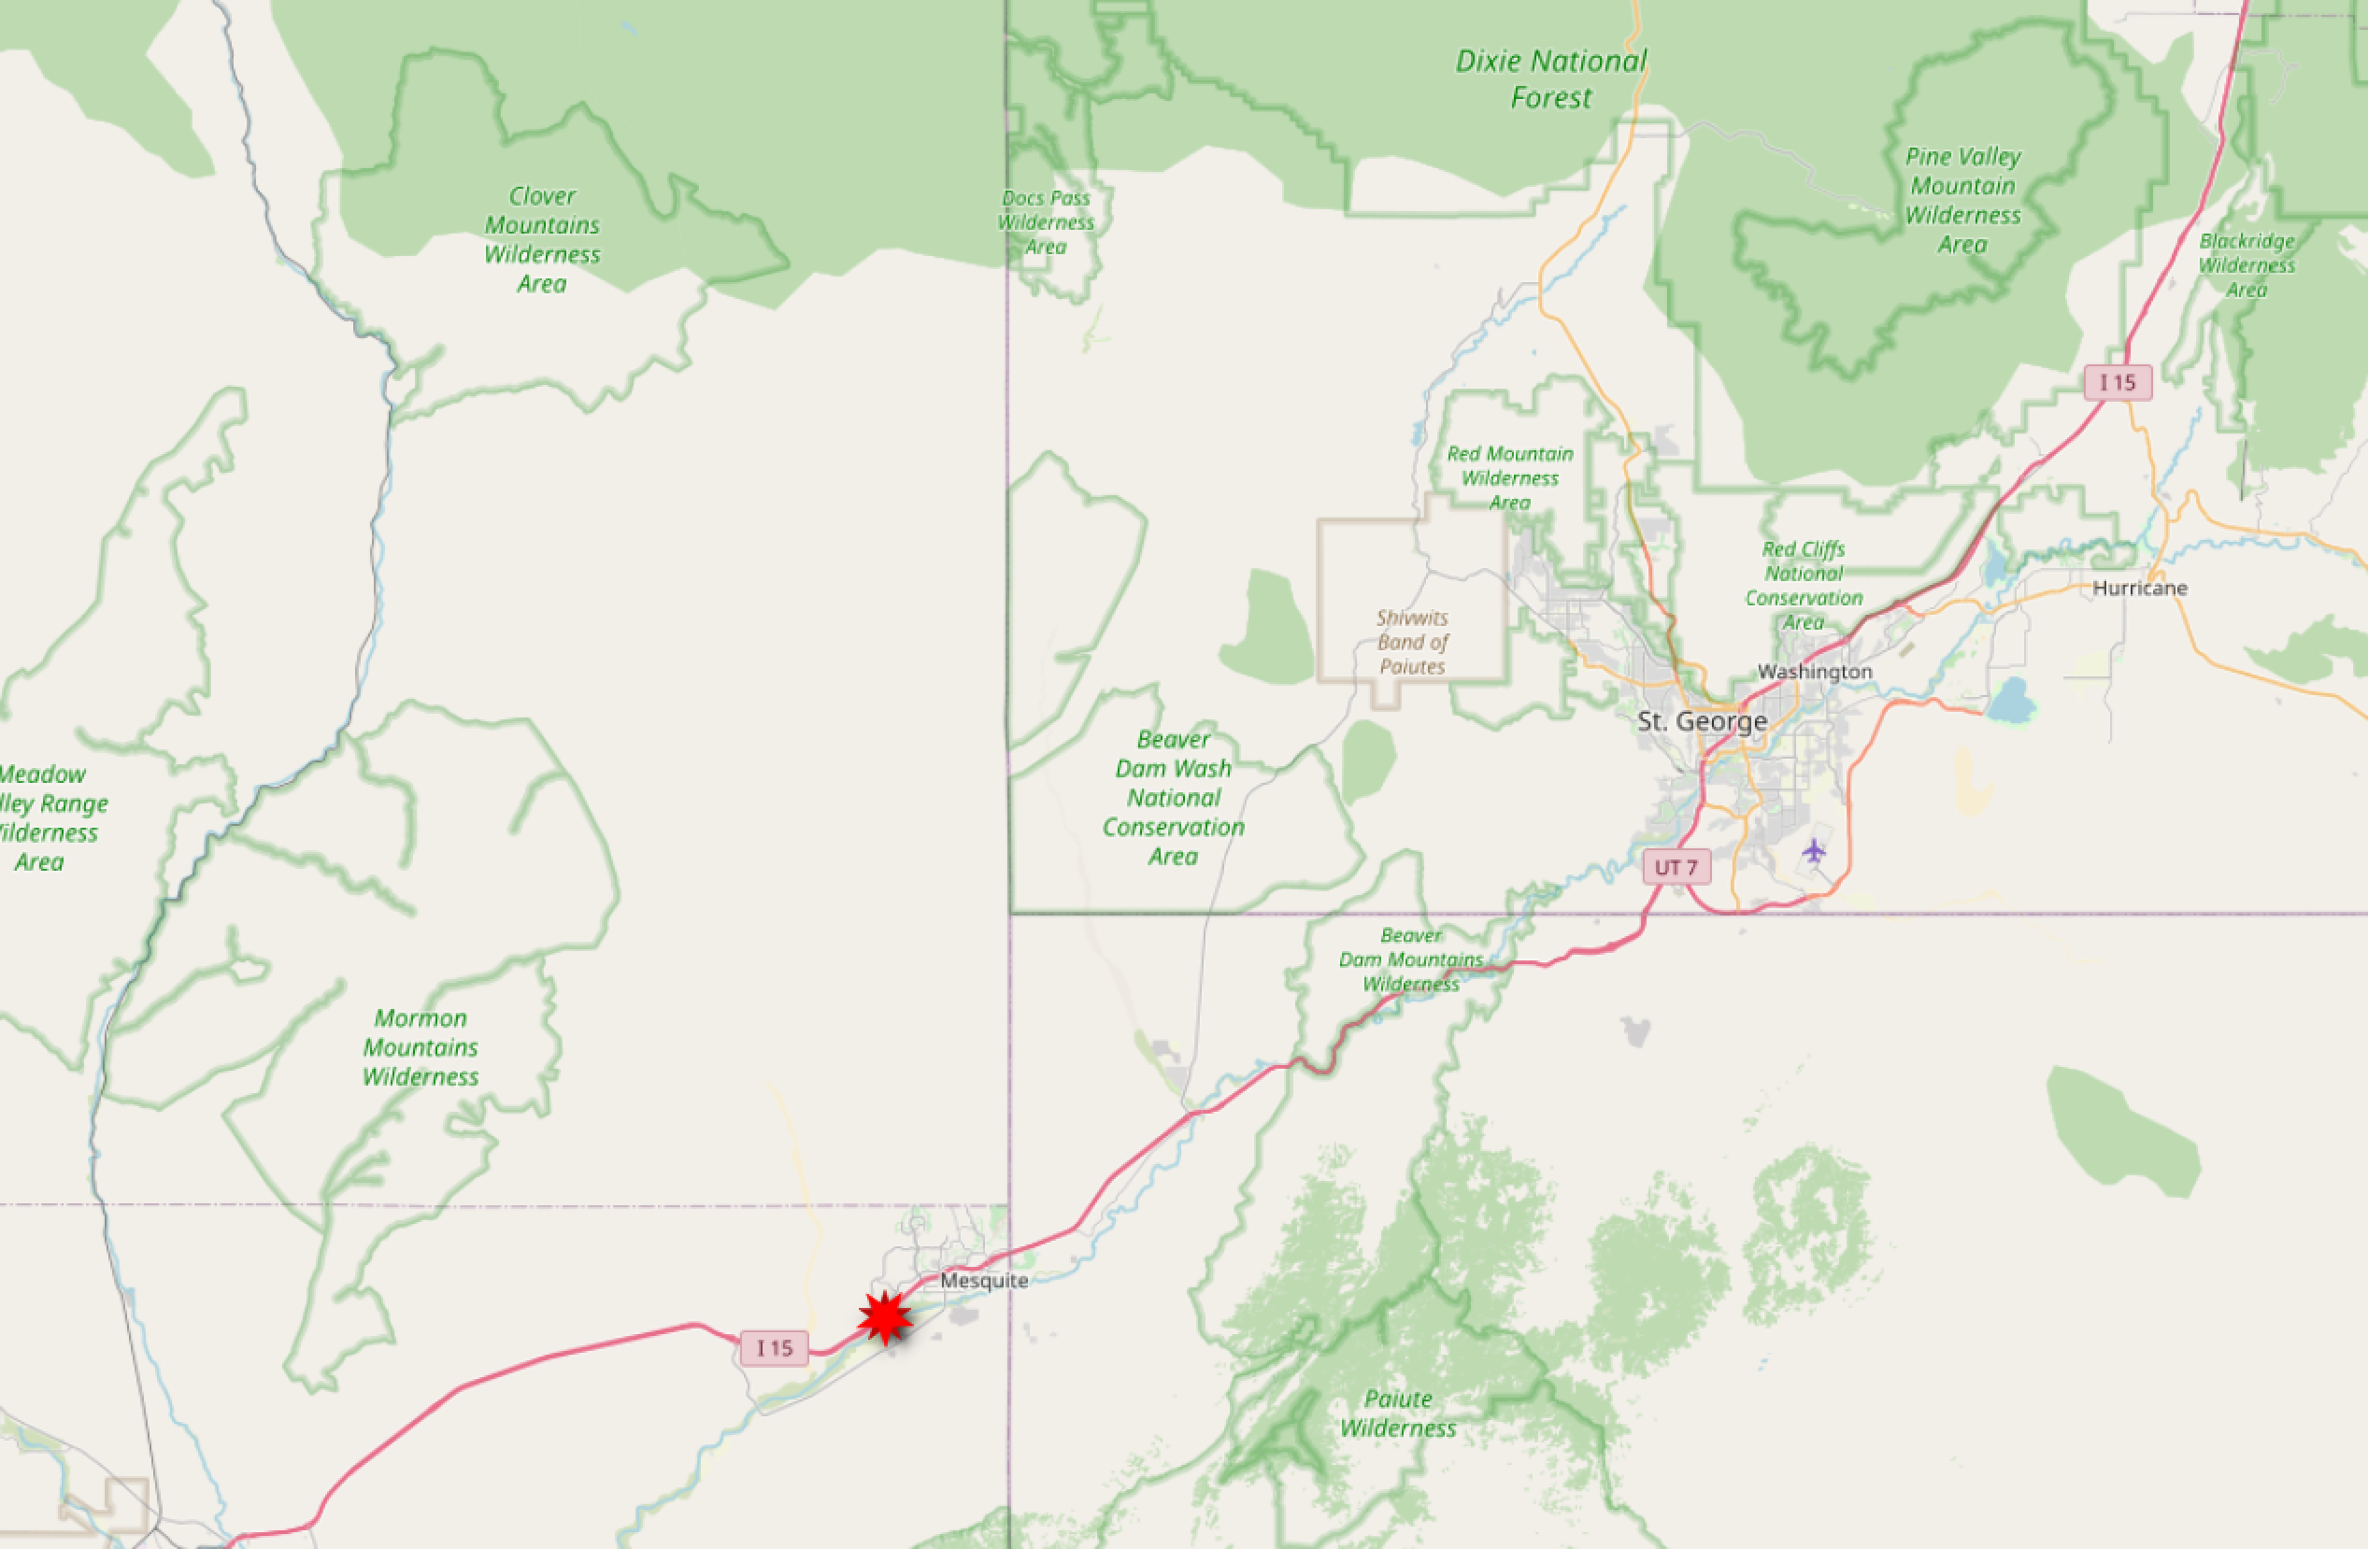
Vision: Integrating with NHD
https://labs.waterdata.usgs.gov/api/nldi/linked-data/nwissite/USGS-364700114080301

Slide 10
Vision
https://labs.waterdata.usgs.gov/api/nldi/linked-data/nwissite/USGS-364700114080301/UM?distance=100
Notes:
And harverst the links in that page.

Slide 11
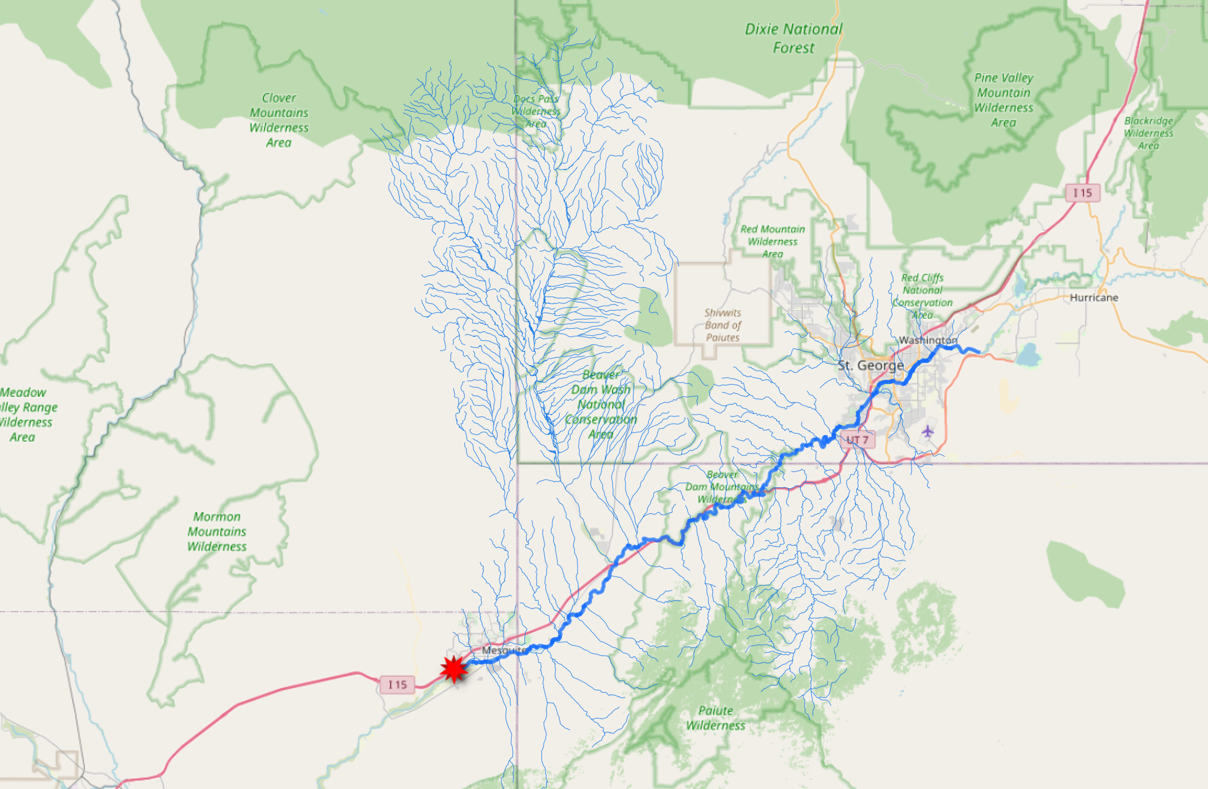
Vision
https://labs.waterdata.usgs.gov/api/nldi/linked-data/nwissite/USGS-364700114080301/UT?distance=100
Notes:
And harverst the links in that page.

Slide 12
Vision
https://labs.waterdata.usgs.gov/api/nldi/linked-data/nwissite/USGS-364700114080301/UT/nwissite?distance=100
Notes:
And harverst the links in that page.

Slide 13
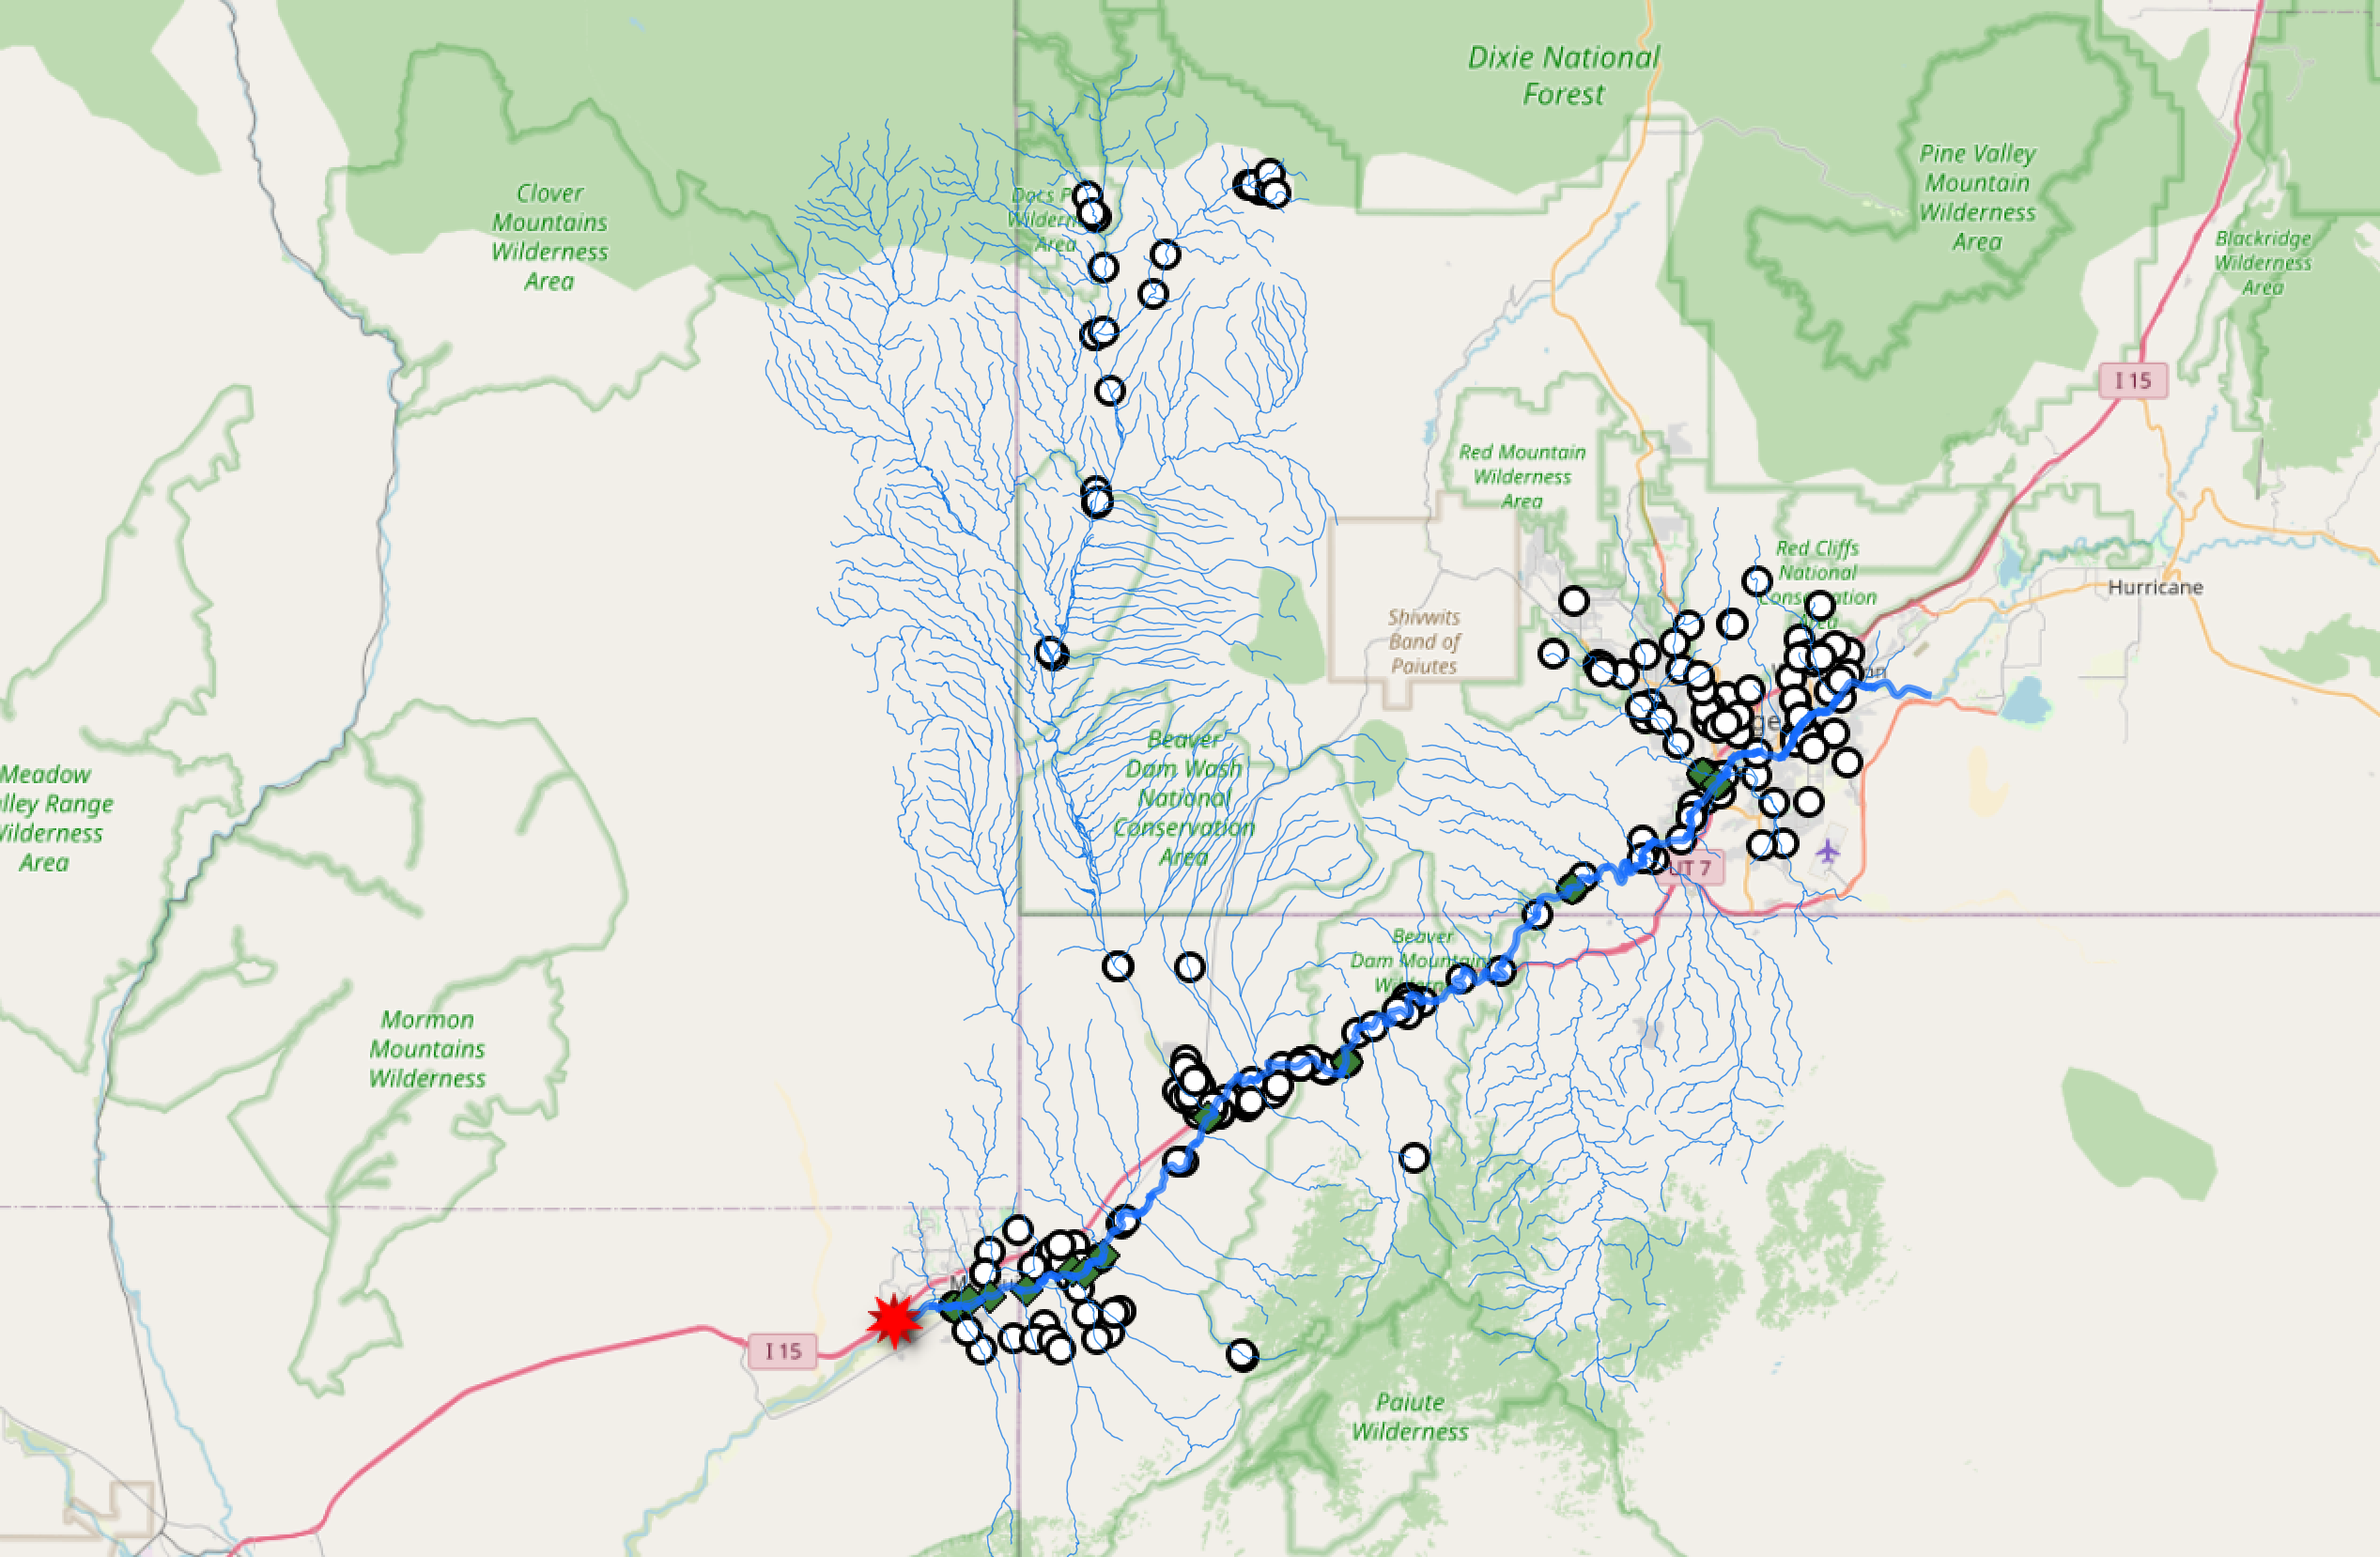
Vision
https://labs.waterdata.usgs.gov/api/nldi/linked-data/nwissite/USGS-364700114080301/UT/wqp?distance=100
Notes:
And harverst the links in that page.

Slide 14
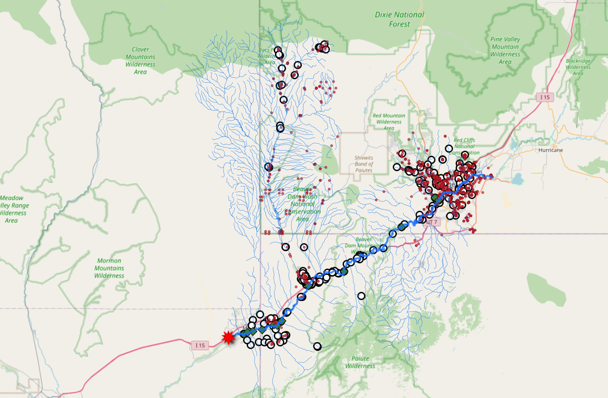
Vision
https://labs.waterdata.usgs.gov/api/nldi/linked-data/nwissite/USGS-364700114080301/UT/wade?distance=100
Notes:
And harverst the links in that page.

Slide 15
Vision
https://labs.waterdata.usgs.gov/api/nldi/linked-data/nwissite/USGS-364700114080301/UT/pws?distance=100 ????
Notes:
And harverst the links in that page.

Slide 16
Engagement

Slide 17
California
Building state capacity

Slide 18
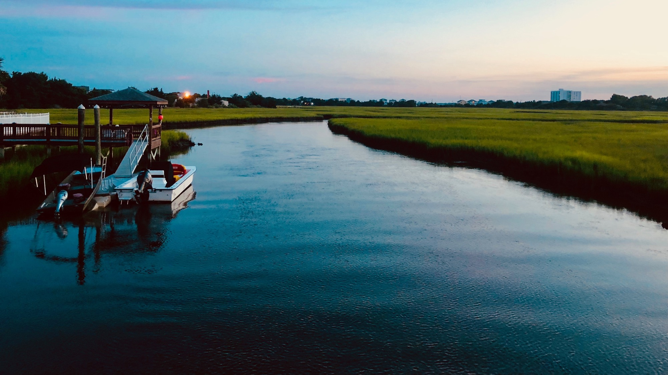
North Carolina
Water Supply Dashboard

Slide 19
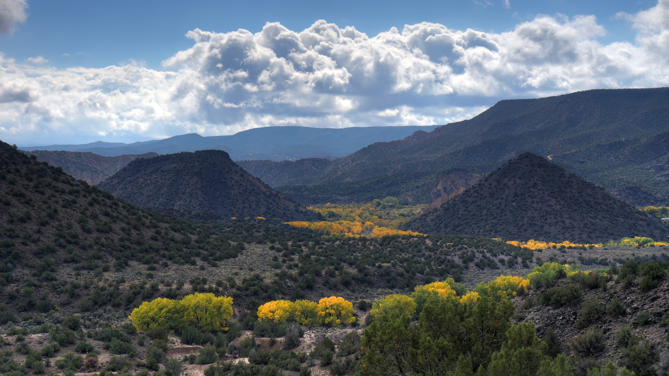
New Mexico
Groundwater pumping for irrigation

Slide 20
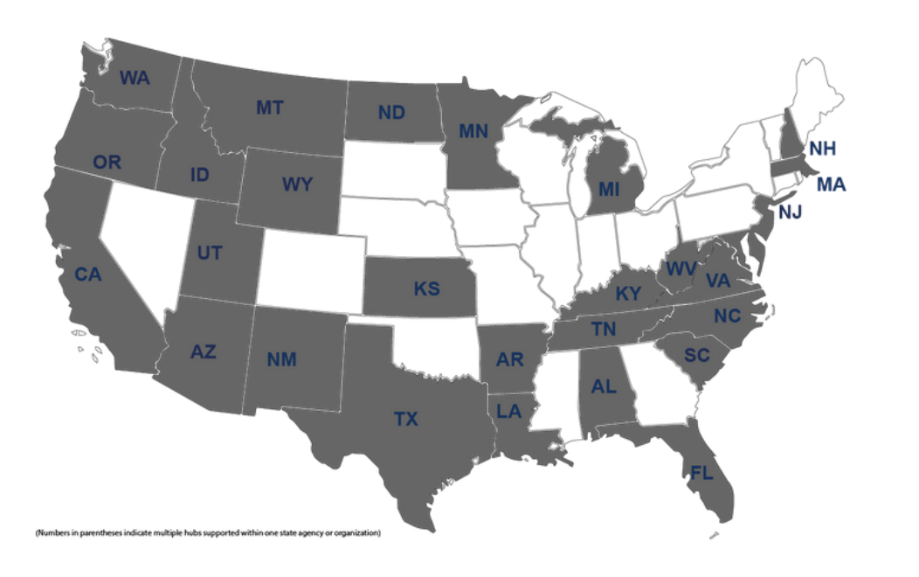
IoW P2P Network
National Network
Webinars
Community Forum
Spotlights
Notes:
KYLE

